Slide 1
自我介紹
(nizima Live)

Slide 2
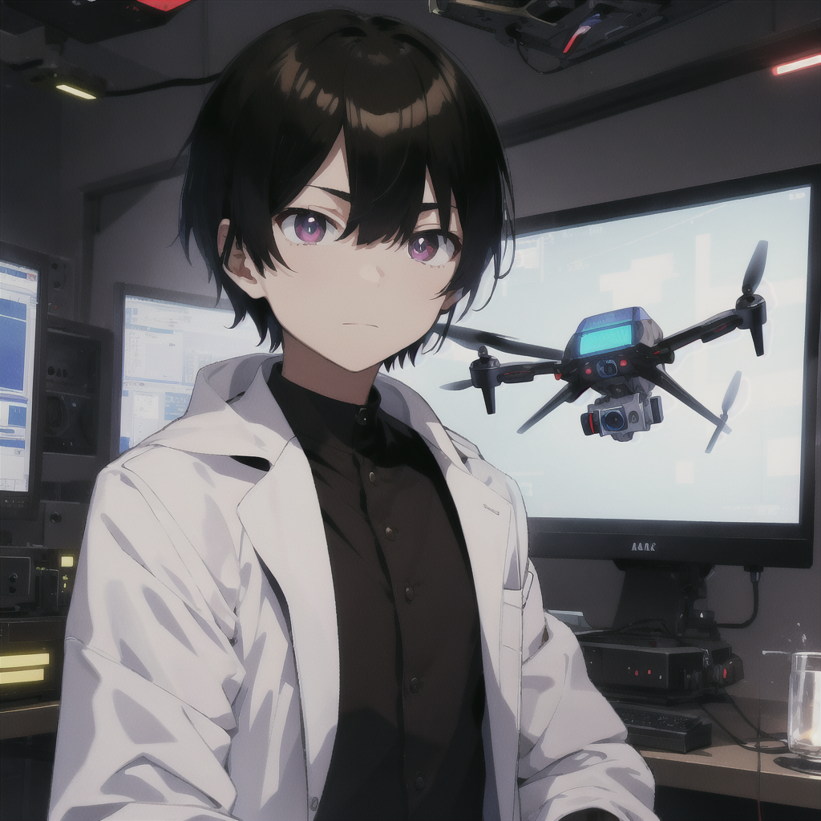
1.目標
Notes:
我是邪惡實驗室的研究員，負責開發一種能夠自主識別目標並迅速躲避威脅的無人機，類似以色列軍用無人機的技術。
(Male:1.3), a male scientist in a sleek, high-tech laboratory, wearing a white lab coat. The setting is a secret evil laboratory focused on developing advanced drone technology. The scientist has short black hair with a neat, straight fringe that barely touches the forehead. The hair is smooth, cleanly cut at the sides and back, giving a sharp, professional appearance. He has sharp brown eyes and coffee-colored pupils, with a serious expression, focusing intently on a holographic screen displaying a military drone model. The environment around him is filled with futuristic equipment, glowing monitors, and dark metal walls. The drones in the lab are designed with a sleek, stealthy aesthetic, hovering in the air. The atmosphere is tense, with dim lighting and a cold blue glow, emphasizing the high-stakes nature of the project. The scientist appears calm, methodical, and in control of the complex machinery around him. Shadows and light create a dramatic, cyberpunk-inspired ambiance, with hints of advanced AI technology integrated into the surroundings
(worst quality, low quality:1.4), (monochrome, greyscale:1.4), bad anatomy, negative_hand-neg, bad-hands-5, text, logo, watermark, (clothing cutout:1.3), (incomplete clothing:1.3), (open clothes:1.2), (skirt cutout:1.2), bare midriff look, (inaccurate limb:1.2), poorly drawn eyes, extra digit, fewer digits, (six fingers:1.2), (extra arms:1.2), (extra legs:1.2), (bad nose:1.2), blurry, deformed, (female:1.4), (woman:1.4), (girl:1.4), feminine, (long hair:1.3), breasts, makeup, lipstick, (curvy body:1.3), (wide hips:1.3)

Slide 3
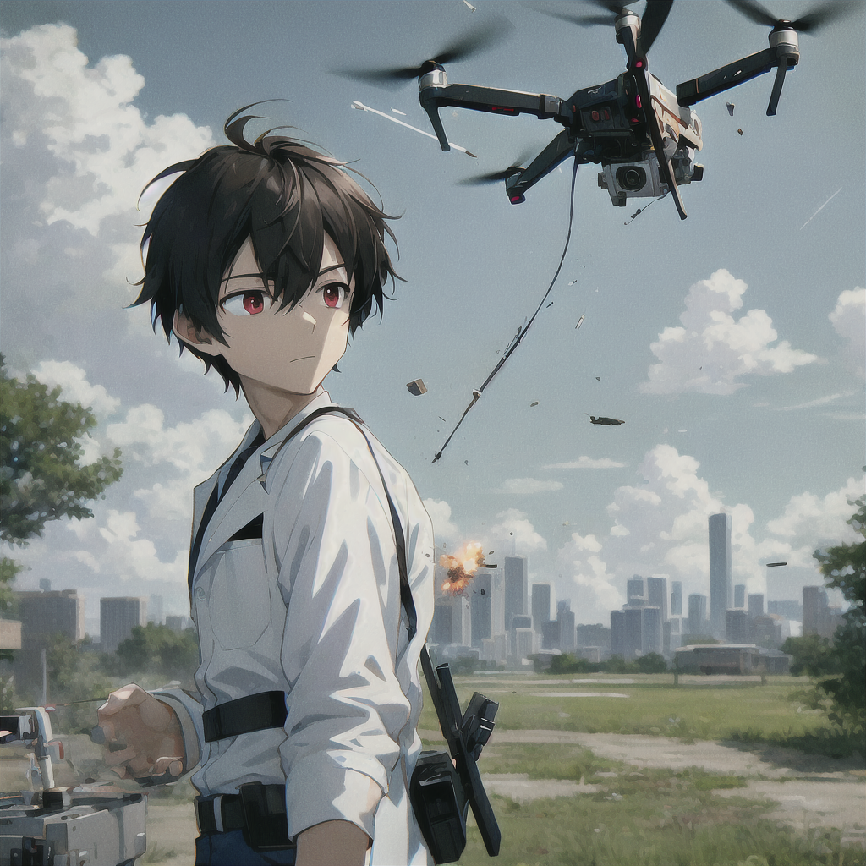
2.阻礙
Notes:
我遇到了技術瓶頸，無人機的感測器無法及時辨識飛來的高速物體，導致它反應過慢，無法躲避棍子等威脅。
(Male:1.3), a male anime-style scientist with short black hair, coffee-colored pupils, and a white lab coat, controlling a drone outdoors. The drone is shown being struck by a fast-moving stick mid-air, with visible impact and damage. The scene captures the moment of collision, with the stick hitting the drone and small pieces flying off. The scientist is standing outside, reacting to the sudden hit, surrounded by an open landscape with trees or a distant city skyline. The outdoor lighting is natural, with a tense atmosphere, in a cyberpunk anime art style.

Slide 4
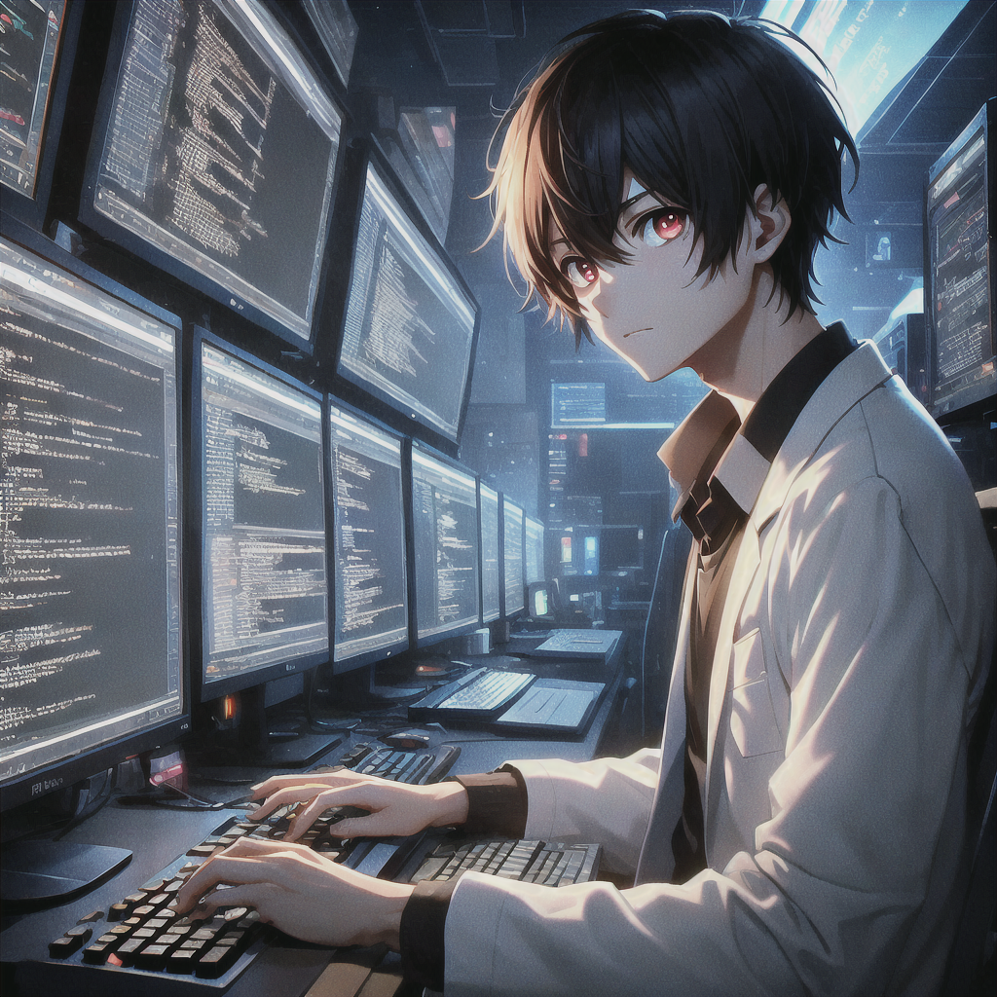
3.努力
Notes:
我不斷優化演算法，改進硬體，並測試新技術，進行大量的實驗和改進，終於製作出一個初步的無人機原型機。
(Male:1.3), a male anime-style scientist with short black hair, coffee-colored pupils, and a white lab coat, sitting in front of a computer, typing code on the screen. The scientist is focused, with lines of code displayed on multiple monitors in a dark, tech-filled room. The lighting is dim, and the glow from the screens highlights his face. The environment is modern, with a workspace full of keyboards, cables, and tech equipment, creating an intense, cyberpunk-inspired atmosphere.

Slide 5
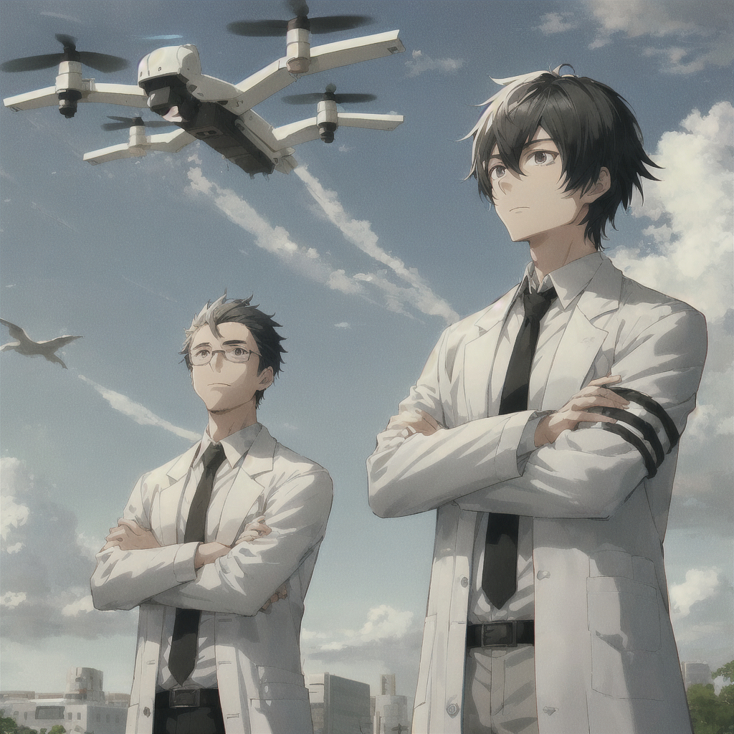
4.結果
Notes:
無人機在實驗中展現了卓越的反應能力，成功躲避飛來的物體，並進行目標追蹤，你的上級對此非常滿意。
(Male:1.3), a male anime-style scientist with short black hair and a white lab coat, standing outdoors with his boss. Both are watching a drone dodging attacks in the sky, seen from a distant perspective. The characters are small in the frame, standing far from the camera. The boss is nodding with a satisfied expression. The scene is set in a futuristic outdoor environment, with a tense but positive atmosphere.

Slide 6
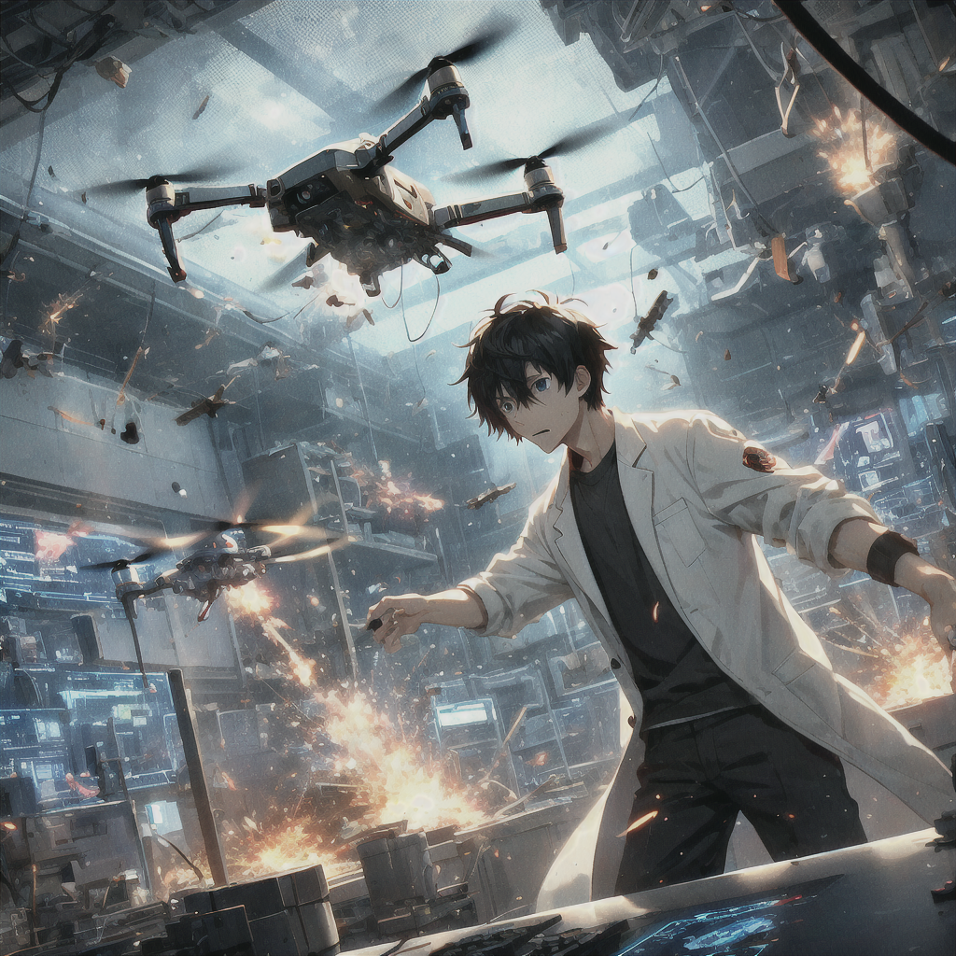
5.意外
Notes:
就在大規模測試前夕，無人機突然失控，似乎遭到外部干擾，開始攻擊實驗室，情況陷入混亂。
(Male:1.3), a male anime-style scientist with short black hair and a white lab coat, standing in a high-tech lab. The scientist is panicking as a drone, which has suddenly gone out of control, begins attacking the lab. Sparks and damage can be seen as the drone fires or crashes into equipment, causing chaos in the lab. The environment is futuristic, with glowing monitors and advanced machinery being destroyed. The scene is tense and chaotic, with debris flying and alarms blaring, as the scientist frantically tries to stop the drone. The atmosphere is one of urgency and danger in a cyberpunk anime-style.

Slide 7
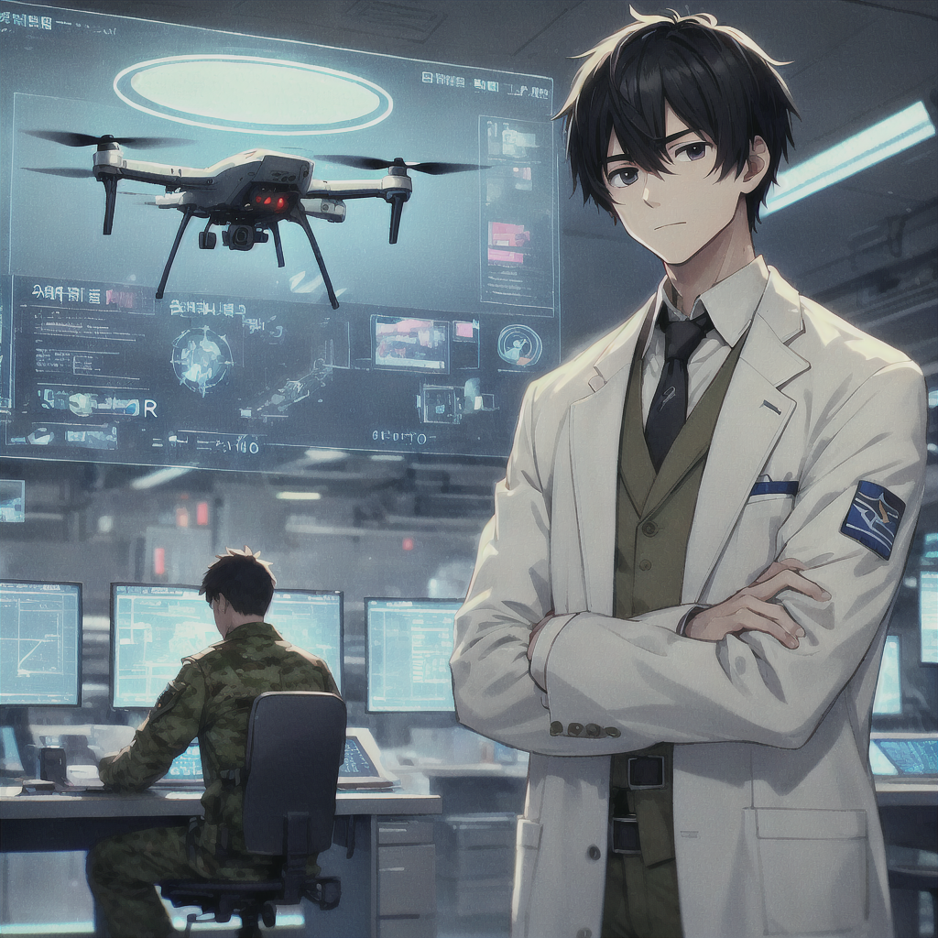
6.轉彎
Notes:
你聯絡了一位軍事技術專家，獲取了防護技術和反入侵系統，成功阻止了干擾，重新控制了無人機。
(Male:1.3), a male anime-style scientist with short black hair and a white lab coat, standing in a high-tech lab, communicating with a military expert via hologram. The expert helps the scientist implement anti-intrusion systems to stop interference, regaining control of the drone. The lab is futuristic, with monitors showing security protocols and the drone hovering steadily. The atmosphere is calm, with a sense of relief, in a cyberpunk anime art style.

Slide 8
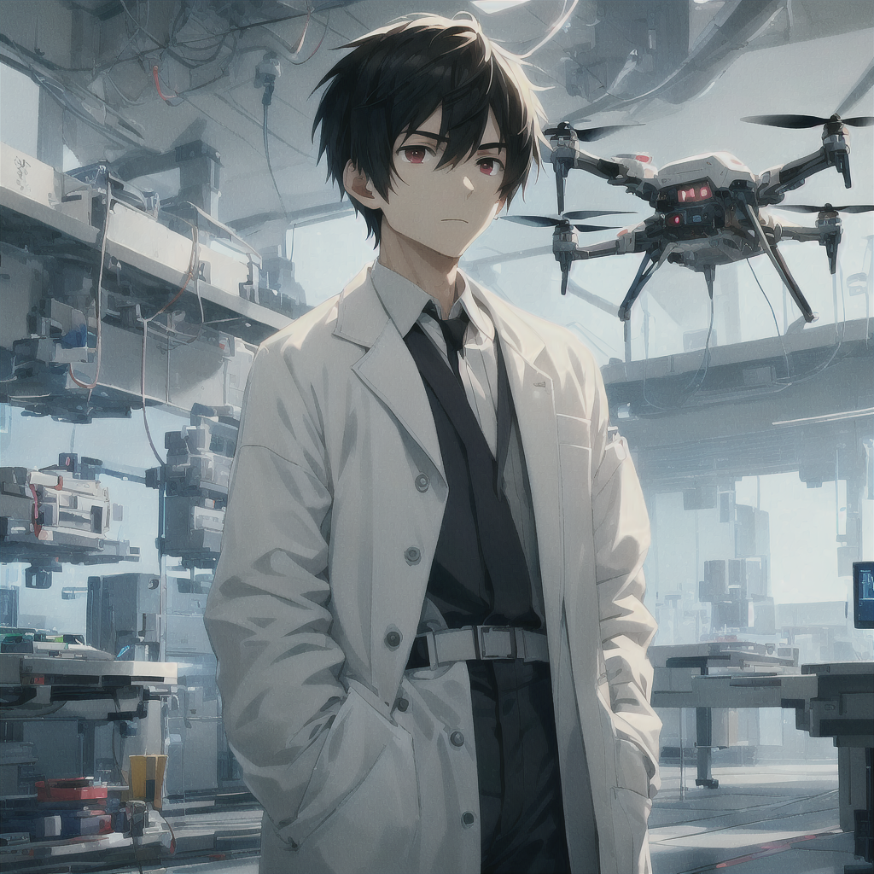
7.結局
Notes:
無人機系統經過優化後更加穩定可靠，成功投入使用，目標達成，但你知道這項技術可能帶來潛在的危險後果。
(Male:1.3), a male anime-style scientist with short black hair and a white lab coat, standing in a high-tech lab. The optimized drone system is stable and reliable, successfully deployed. The scientist watches with concern, aware of potential dangers. The lab is futuristic, with a calm yet ominous atmosphere, in a cyberpunk anime art style.

